Slide 1
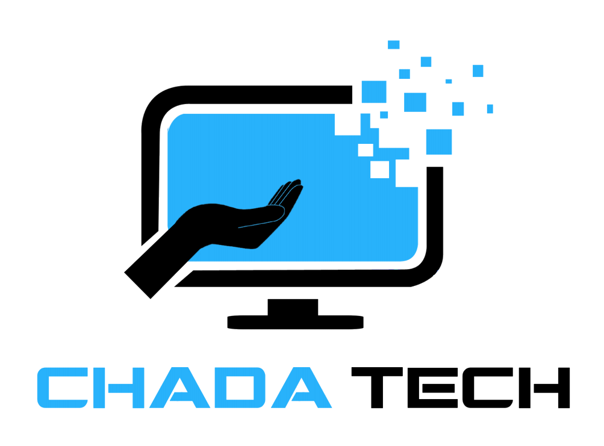
Agile Development
Michael Waxler

Slide 2

Scrum Team Agile Roles:
Product Owner
As a product owner, you will ensure the Scrum team aligns with the overall goals (Staff, 2023). You will be responsible for managing the backlog and prioritizing work based on the clients needs. You will also be maintaining focus within the team while communicating with stakeholders to ensure that progress is continuous.
Development Team
As a member of the development team, you will be doing hands-on work to complete tasks in a Scrum sprint (Staff, 2023). Development teams consist of engineers, designers, analysts, testers, or any role needed to reach the sprint goal. As a member of the team, you will help with planning and goal settings during each sprint. You will help test the product, providing feedback that will be used to improve the product.
Scrum Master
As a Scrum Master, you will be responsible for ensuring that a Scrum team is operating as effectively as possible with Scrum values (Staff, 2023). You will help facilitate daily Scrums, lead the sprint planning meetings, and be responsible for conduiting reviews to see what went well and what can be changed for upcoming sprints. You also will manage any challenges for the team by speaking directly to stakeholders.

Slide 3
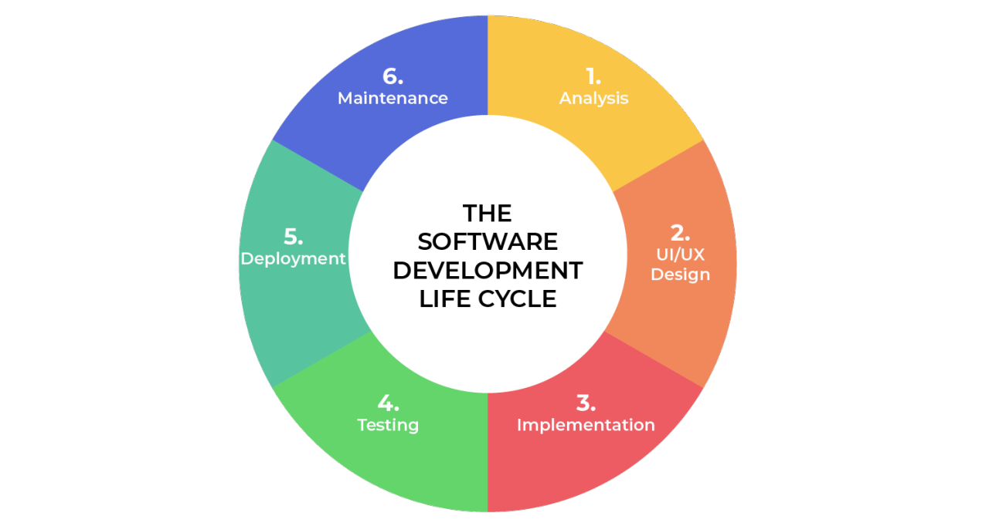
SDLC Phases of Agile:
Analysis
Collaborate with stakeholders and clients directly.
Gather information and requirements for user needs.
2. Design
Specifies lists of comprehensive procedures for functionality that meets user requirements.
Addresses variables like budget, time constraints, and other restrictions
3. Implementation
Development process is divided into more manageable functional sections.
4. Testing
the procedure for locating and reporting any errors, flaws, or shortcomings in a codebase.
5. Deployment
After completing all testing and development, the product is prepared to enter production and be made available to the public.
6. Maintenance
Throughout time, developers concentrate on introducing new features and resolving bugs.
Fig. 1: The Software Development Life Cycle (Harris, 2021)

Slide 4
Waterfall Model:
The Waterfall model:
Development issues with Waterfall Model:
The waterfall model, also known as the waterfall approach, is a type of process used to conceive, develop, and create a product (Waterfall Model | EBSCO, 2024). The waterfall model is rigid, encouraging developers to establish a vision and goals, then stick to them.
Before beginning to code, all planning would have been completed in advance, with a significant amount of work dedicated to trying to account for every possibility.
The project is not tested until it is nearly complete.
Until the project's development is complete, no feedback is obtained.
If there are any issues or changes needed, the entire cycle starts over.
When considering the SNHU Travel project, an example of where the waterfall approach would not able the best choice would be the change of the list of top destinations to a slideshow.
Feedback for such a change when using the waterfall model would not have happened until the product was finished. This would mean you would need to go back and start over to make this change happen.
If a change is requested during development by a stakeholders, it would not be possible with the waterfall model as it does not allow for changes to happen without completely starting back from the beginning of the cycle.

Slide 5
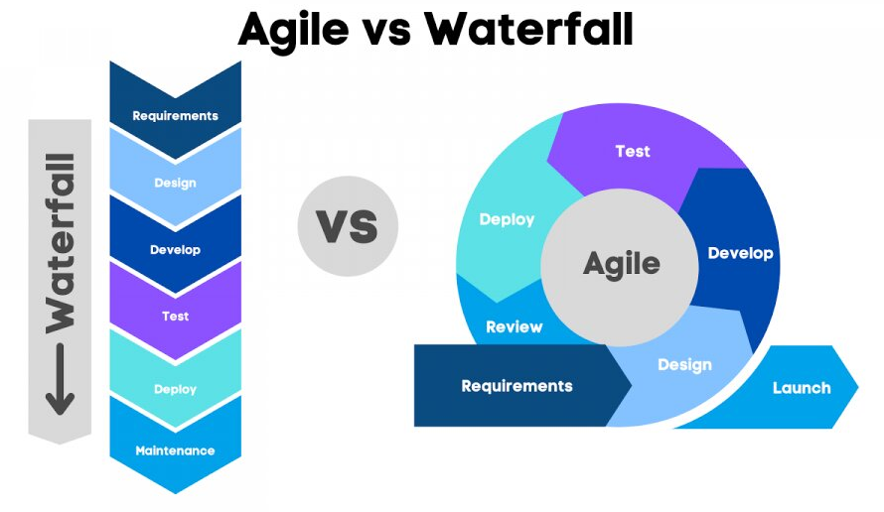
Agile vs Waterfall:
Waterfall
Linear, rigid approach
Little to no feedback during development
Changes require starting over or extra planning
Agile
Circular, flexible approach
Feedback provided as each section of design finishes
Changes can occur as needed based on provided feedback
Fig. 2: Agile vs Waterfall (Waterfall vs Agile: Which Is Better for You and Why?, 2023)
When considering waterfall vs agile for a design approach, you need to consider all the factors. If that it seems as if you have a clear and fixed requirements, waterfall is good fit. Otherwise, if that you need to have flexibility and to be able to adapt as needed, agile would be more beneficial. In general, agile is the better choice for projects as it allows for more collaboration, more feedback from stakeholders, and changes to happen without having to start over. When thinking back to the SNHU Travel project, agile was the perfect fit as it allowed for changes to happen over the course of the project. If the waterfall approach was used instead, there were a number of instances when starting back at the beginning would have occurred.

Slide 6
References:
Staff, C. (2023, November 29). The 3 Scrum Roles and Responsibilities, Explained. Coursera. https://www.coursera.org/articles/scrum-roles-and-responsibilities
Harris, R. (2021, May 20). Software Development Life Cycle (SDLC). Www.linkedin.com. https://www.linkedin.com/pulse/software-development-life-cycle-sdlc-tutorial-richard-harris/
Waterfall model | EBSCO. (2024). EBSCO Information Services, Inc. | Www.ebsco.com. https://www.ebsco.com/research-starters/computer-science/waterfall-model
Waterfall Vs Agile: Which is better for You and Why? (2023, January 31). Www.linkedin.com. https://www.linkedin.com/pulse/waterfall-vs-agile-which-better-you-why-datacademy-cloud

